Slide 1

Program control statements

Slide 2
Conditional statements
If
If – else
If – elif
Nested if

Slide 3
logical conditions
Equals: a == b
Not Equals: a != b
Less than: a < b
Less than or equal to: a <= b
Greater than: a > b
Greater than or equal to: a >= b

Slide 4
Simple if
Checks the condition, if the condition is true it will execute the statement.
The statement will be given with an indentation (space)

Slide 5
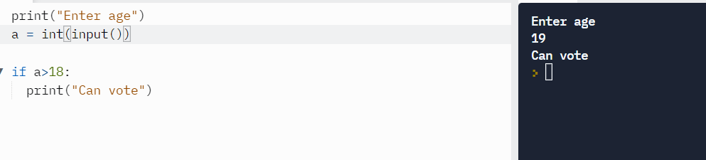
Simple if statement - example.

Slide 6
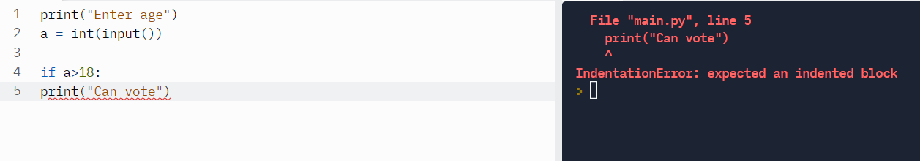
Error if indentation is not given properly

Slide 7
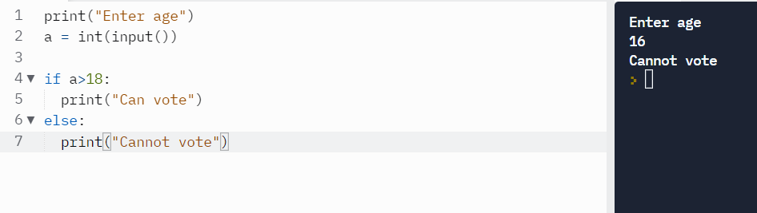
If - else
If the condition is true , statement inside the if will be executed,
Otherwise the statement inside else will be executed,
If and else should have “:”

Slide 8
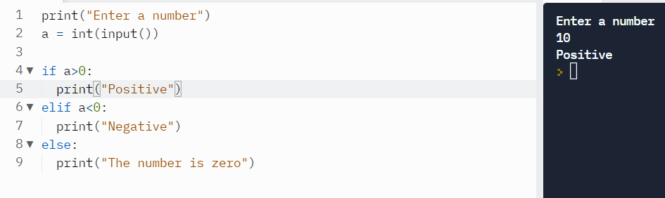
If elif
This statement is used when you have more than one condition has to be checked

Slide 9
AND, OR
AND and OR statements are used when you have 2 or more condition to be checked simultaneously.
AND – If all the conditions are satisfied, it will return True else return False.
OR – This will return True if any one condition is satisfied.

Slide 10
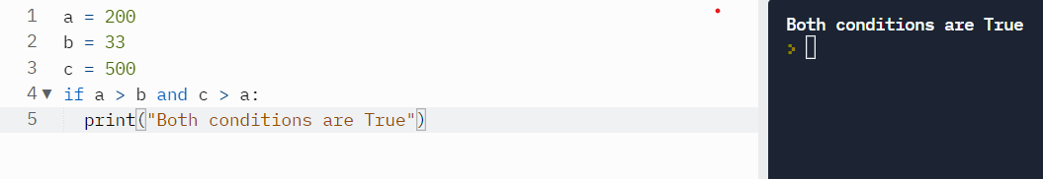
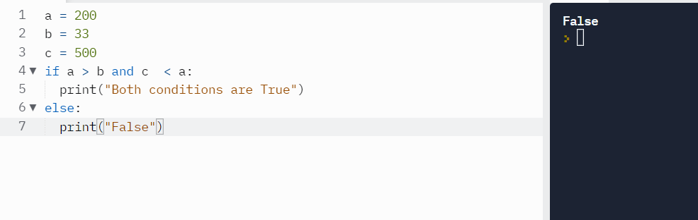
Example

Slide 11
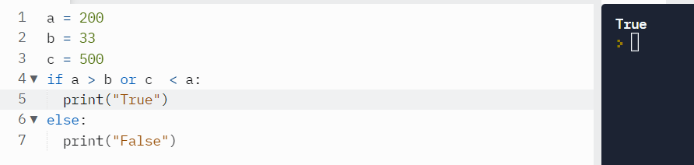
Using OR statement

Slide 12
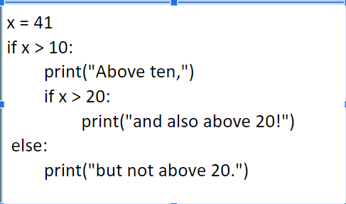
Nested if
If inside another if is known as nested if.

Slide 13
Explanation
1st python will check x>10 if that is true then it will print “above ten”.then it will come to next command, which is x > 20 , if that is true then we get “and also above 20!”.
If that both statements are false we get else statement.

Slide 14
Question
Find grade of a student, taking name, marks of 5 subjects.
Find Total marks and percentage.
100 – 90 – A+
90 – 89 – A
80 – 79 – B+
70 – 69 – B
60 – 79 – C+
50 – 59 - Fail

Slide 15
Looping and Iteration
Looping - Is to repeat something.
There are 2 types of loop :
  For loop
  While loop
For loop it will work with a limit
While loop, will work with limit and without limit

Slide 16
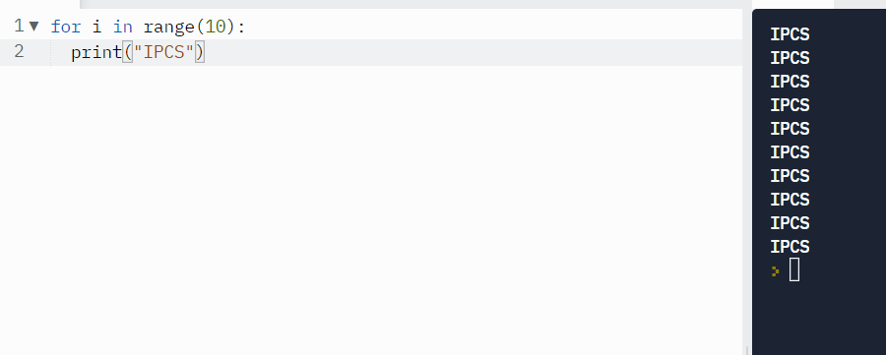
For loop
Syntax :
  for variable in range(limit):
    statements
    The statement should begiven with an indentation

Slide 17
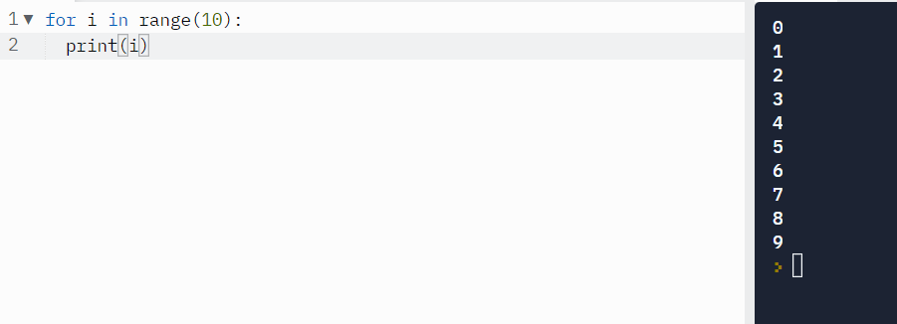
Print numbers using for loop
Print numbers from 0 to 9

Slide 18
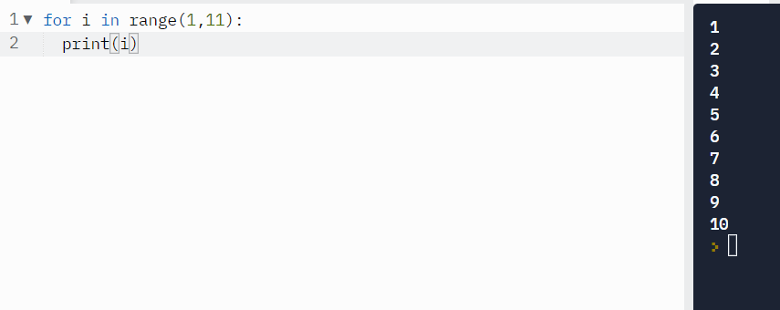
continue
Printing numbers from 1 to 10

Slide 19
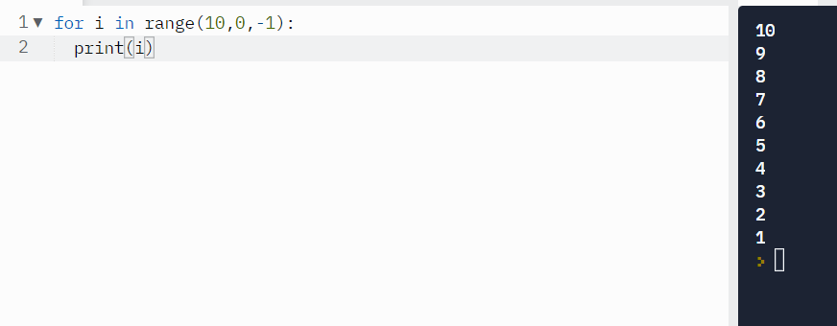
continue
Print numbers from 10 to 1

Slide 20
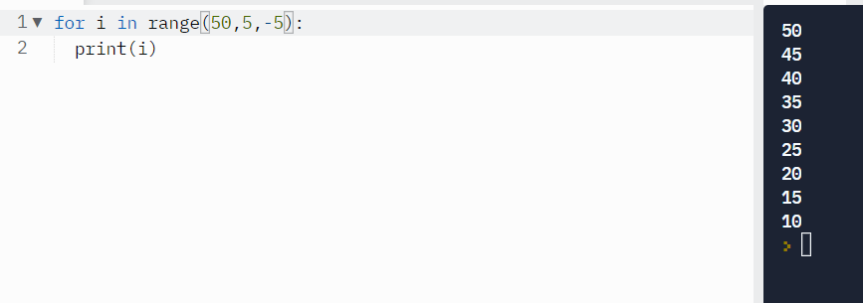
continue
Printing numbers from 50 to 10

Slide 21
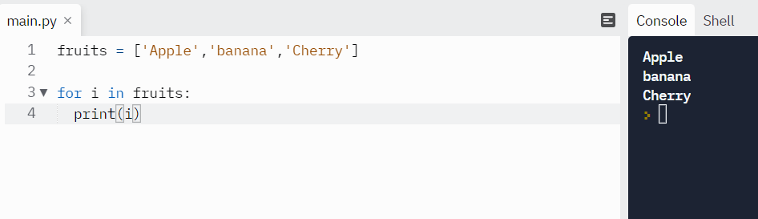
Loop on data structure

Slide 22
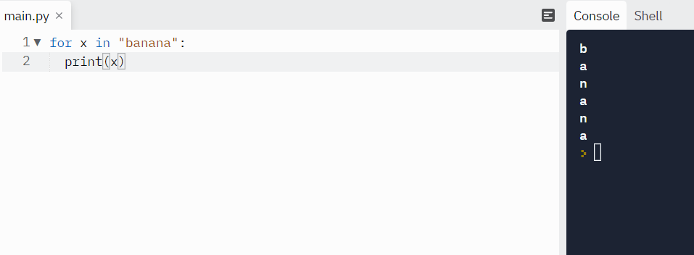
Looping through strings

Slide 23
Questions
Print all even numbers from 1 to 50 using loop and % operator
Print sum of numbers up to limit provided by user using loop.

Slide 24
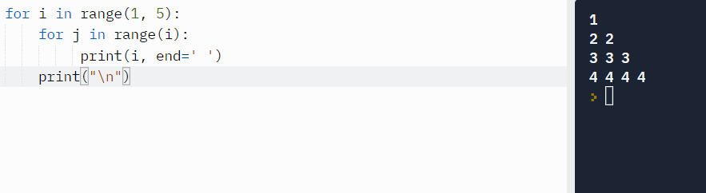
Nested loop
Loop inside another loop is known as nested loop

Slide 25
Create pattern
*
* *
* * *
* * * *

Slide 26
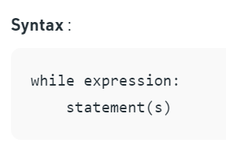
While loop
While loop is also used to repeat an action.
While can also work in the cases where there is no limit, the limit can be decided by the user.

Slide 27
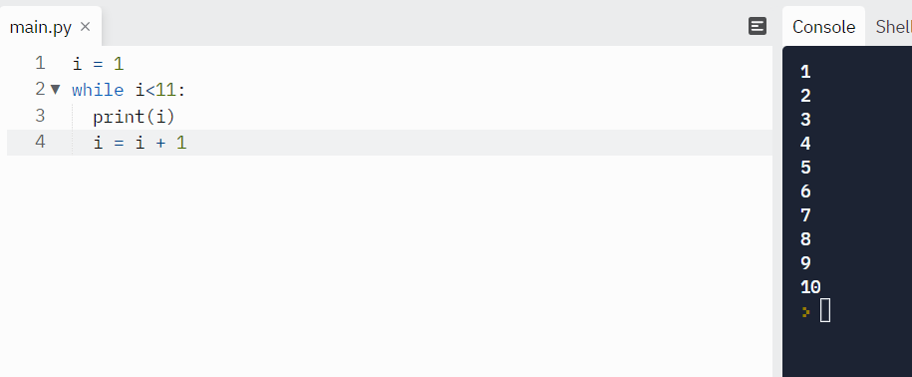
Print numbers from 1 to 10 using while loop

Slide 28
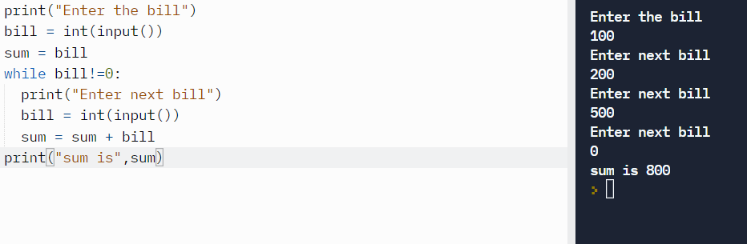
Print sum of all bills entered by the user

Slide 29
Question
Imagine 2 candidates there for Election. Mr. Alex and Mr. Manu
User can cast the vote, either V or M and q for Quit
Find who is the winner and print the number of votes secured for each.

Slide 30
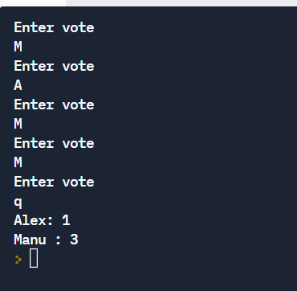
Sample output

Slide 31
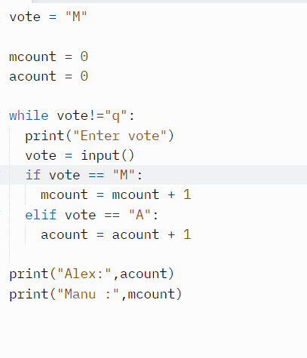
Program

Slide 32
Continue
The continue statement in Python returns the control to the beginning of the while loop. The continue statement rejects all the remaining statements in the current iteration of the loop and moves the control back to the top of the loop.
The continue statement can be used in both while and for loops.

Slide 33
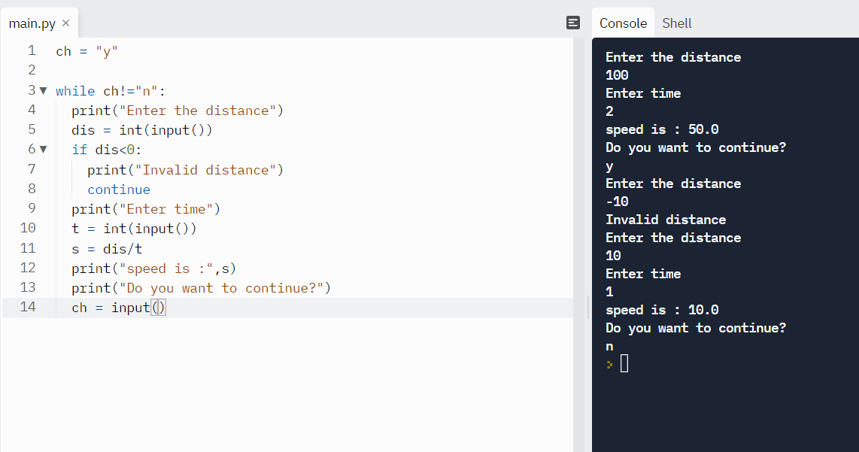
Example program
Getting distance and Time from the user and calculate the speed, if the user enters negative value for distance, repeat the question again.

Slide 34
Break statement
The break statement in Python terminates the current loop and resumes execution at the next statement, just like the traditional break found in C.
The most common use for break is when some external condition is triggered requiring a hasty exit from a loop. The break statement can be used in both while and for loops.

Slide 35
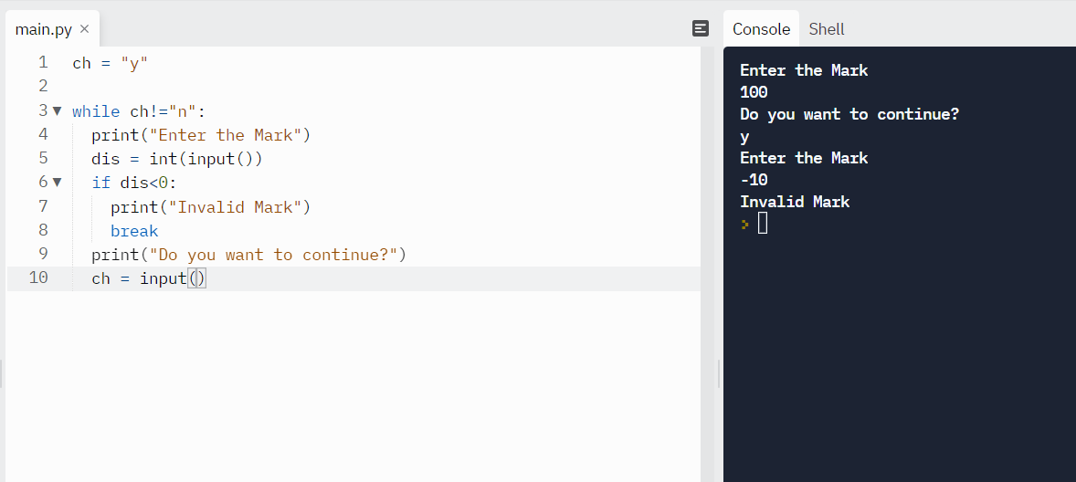
Example

